Slide 1

Spotting a Bad Privacy Policy in 5 Minutes
August 2025

Slide 2
OUR ORGANIZATION
Security Matters (SecM) is a NGO working to protect at-risk groups in East and Southeast Asia by strengthening their digital and physical security.
We achieve this by:
Promoting digital security awareness
Serving as the first point of contact for security threats
Providing first responder support and resources
Creating localized tools to address unique threats
securitymatters.asia

Slide 3
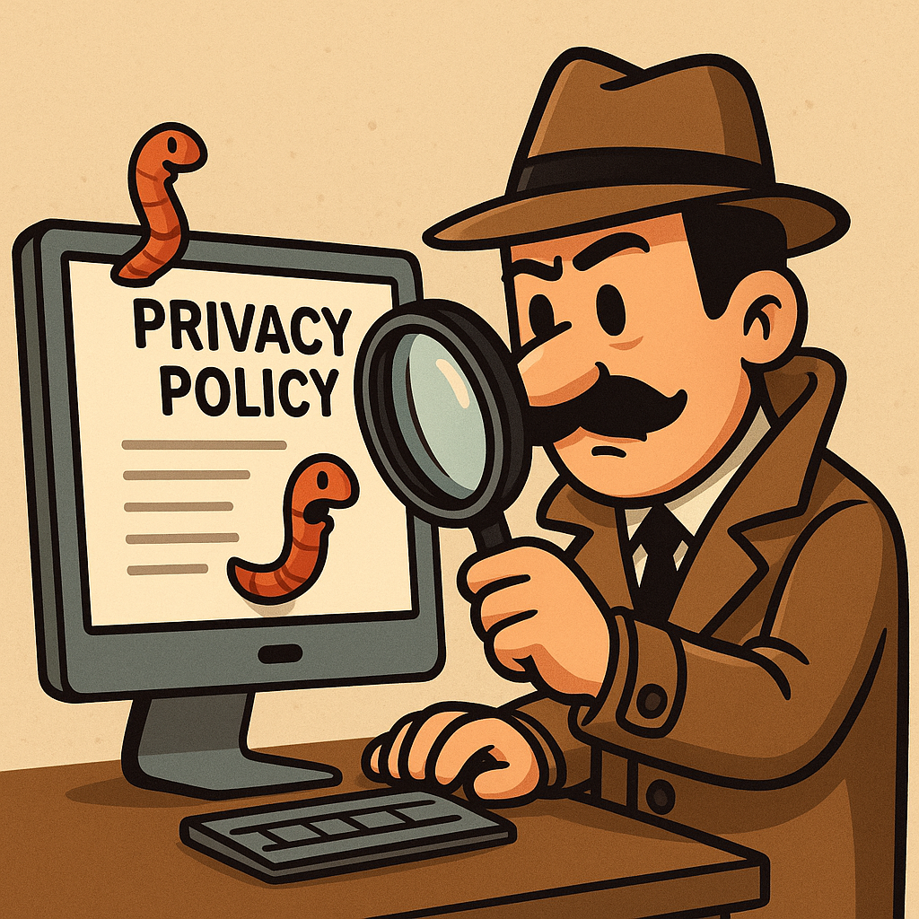
Why Privacy Policies Matter
Privacy policy = company’s promise on how it handles your data.
Bad policy = unclear, outdated, or hides risky practices.
Knowing the red flags helps you decide who to trust.

Slide 4
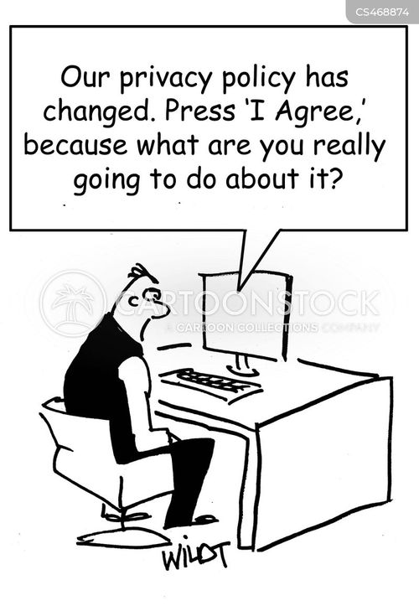
6 Red Flags of a Bad Privacy Policy
Multiple third parties (but no names)
Clever/ambiguous wording
Lack of details
Outdated or missing “last updated” date
Poor readability
No data accountability
Chris Wildt via CartoonStock

Slide 5
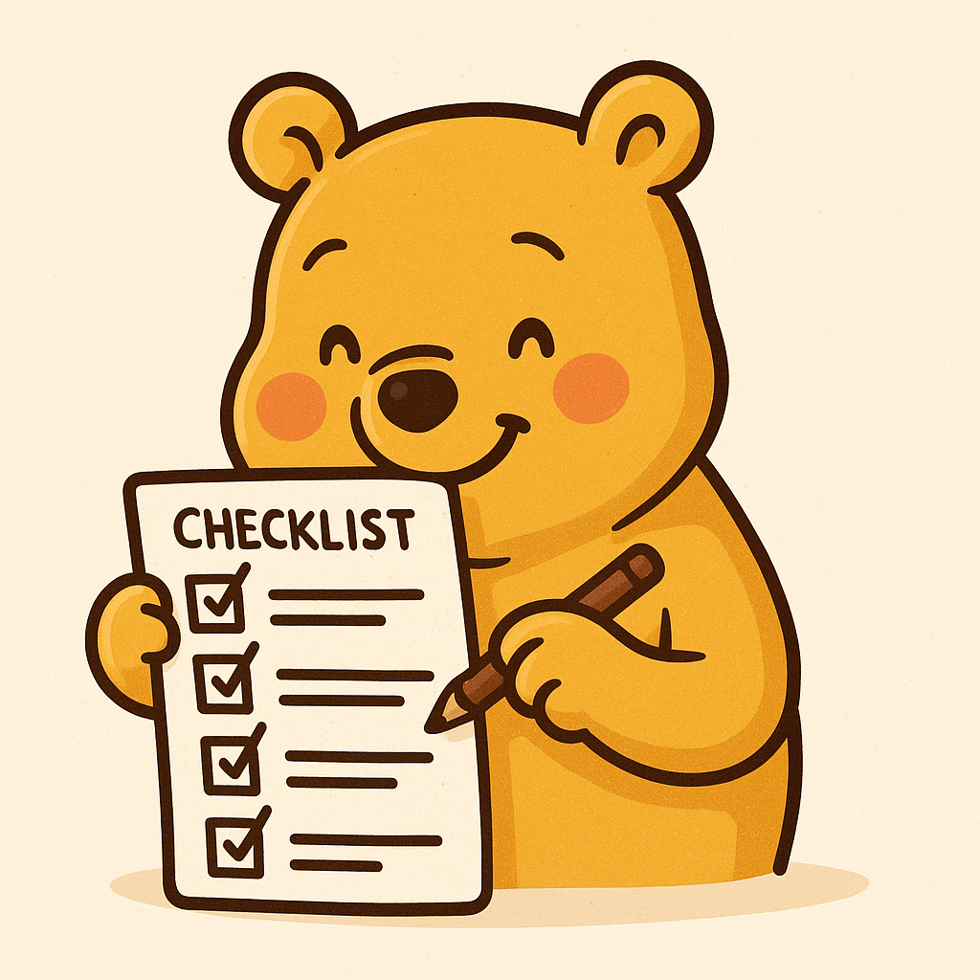
Quick Checklist
Are third parties named?
Is it clear & jargon-free?
Does it have details?
Is it up to date?
Can you read it easily?
Does it explain your rights?

Slide 6
Use ChatGPT to Review Privacy Policies
The prompt:
“You are a digital security trainer helping non-technical people understand privacy policies.
Read the following privacy policy and create a table with these columns:
1. Category (Data Collected, Data Sharing, Policy Updates, Readability, User Rights, Government/Police Access, Cross-Border Data Transfers, Data Retention, Security Measures, Opt-Out & Consent, Overall Verdict)
2. Findings (based on the policy text)
3. Good / Bad Indicator (✅ Good, ⚠️ Mixed, ❌ Bad)
4. Simple Explanation (in plain language, no technical jargon)
For the Overall Verdict, give a short 1–2 sentence summary explaining if the policy is generally good, bad, or mixed, and why.
Privacy policy text:”

Slide 7
Question? Email us at:
info@securitymatters.asia
Thank you!
Text us on WhatsApp or Signal: +60 16-298 2046
@secm8
@sec_matters

